Slide 1
Big Mountain Resort
Evaluation of Ticket price given available facilities

Slide 2
Problem Identification 1
Hypothesis → How can Big Mountain Resort create a ticket pricing strategy that will (1) better leverage the client’s facilities and (2) either cut costs or give more confidence in increasing ticket prices without undermining ticket sales in the long run?
Context
Big Mountain Resort is a ski resort located in Montana.
Big Mountain Resort has recently installed an additional chair lift to help increase the distribution of visitors across the mountain. This additional chair increases their operating costs by $1,540,000 this season.
The resort's pricing strategy has been to charge a premium above the average price of resorts in its market segment.
There are limitations to this approach. The business wants some data-driven guidance on a strategy for selecting a better value for their ticket price.

Slide 3
Problem Identification 2
Criteria for success
Providing a pricing strategy that will better leverage the client’s facilities and either cut costs (without undermining the ticket price) or give more confidence in increasing ticket prices.
Scope → There's a suspicion that Big Mountain is not capitalizing on its facilities as much as it could. Basing your pricing on just the market average does not provide the business with a good sense of how important some facilities are compared to others. You are also considering a number of changes that you hope will either cut costs without undermining the ticket price or will support an even higher ticket price.
Constraints → Data sources are limited to only to 330 resorts in the US and don’t represent 100% of the total market
Key stakeholders
Jimmy Blackburn, the Director of Operations
Alesha Eisen, the Database Manager
Key Data Sources
A single CSV file that was provided by the database manager. The column descriptions in the provided metadata

Slide 4
Modelling Results and Analysis 1
Big mountain currently charges $81 for AdultWeekend tickets (ADT).
Our model suggests that, at present, you should charge $95.87.
The additional operating cost of the new chair lift per ticket (on the basis of each visitor on average buying 5 day tickets) should prompt a $1.99 increase to $97.86.

Slide 5
Modelling Results and Analysis 2
Some data was missing from the dataset but could provide useful insight for a re-evaluation of the model.
This includes:
number of visitors per year
additional data about typical length of stays at these resorts
number of day tickets sold
number of weekly passes sold etc.
If this data is made available, the model can be refined even further

Slide 6
Modelling Results and Analysis 3
To test a new combination of parameters in any given scenario:
The model will be made available for your business analysts to use and explore
Simple linear, piecewise equations can be provided so that the company can make small adjustments to price (up tro stated limits) without another consultation
A simple web-based app can be developed using the insights from this model/analysis.

Slide 7
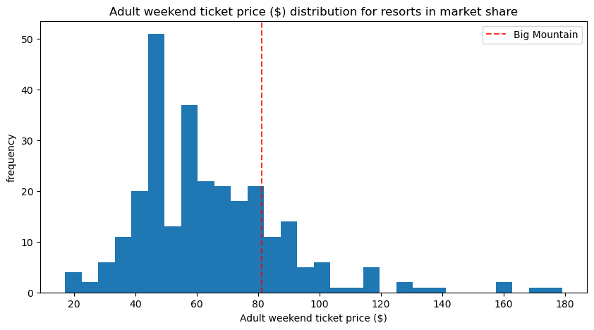
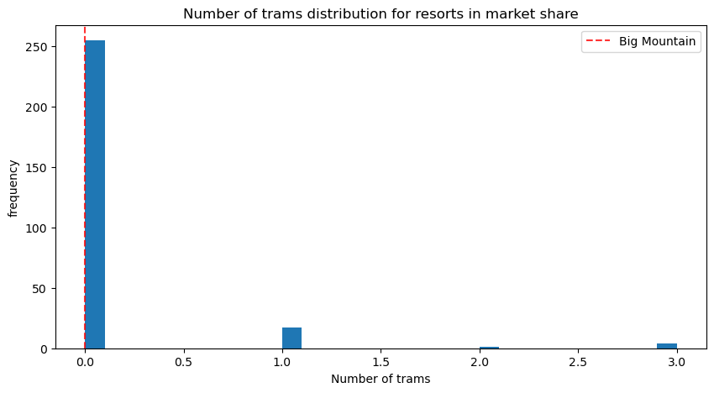
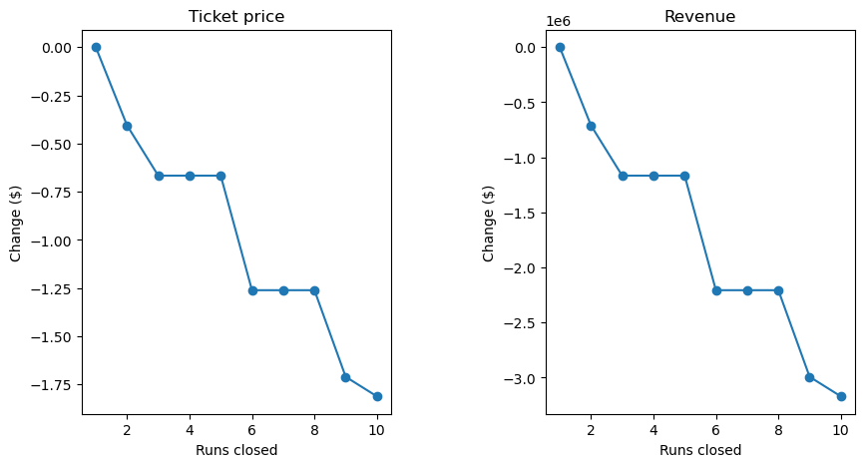
Modelling Results and Analysis 4

Slide 8
Summary and Conclusion
Big Mountain currently undervalues it’s ticket price:
That price can be increased significantly as it stands
That price can rise even further with the inclusion of a new chair lift
The following can trigger a re-evaluation of the model and all calculations:
If more data becomes available on your facilities or your pricing becomes available
If factors other than facilities want to be considered in deciding price
If data on more resorts becomes available

